Slide 1
E-Invoicing in Malaysia
E-Invoicing will be implemented in stages in Malaysia, to enhance Malaysia’s tax administration management.
E-Invoicing
A process of issuing and receiving invoices in an electronic format, a digital representation of a transaction between a supplier and a buyer.
Issued to recognize income of the supplier (proof of income) and as a record for purchases made / spending by the buyer (proof of expense).
Covers all taxpayers undertaking commercial activities in Malaysia. This includes B2B, B2C and B2G type of transactions. The types of e-Invoice includes invoice, credit note, debit note, refund note.
Implementation timeline
Taxpayers with annual turnover >RM100 million
1 Aug 2024
All other taxpayers
1 July 2025
Taxpayers with annual turnover of RM25 million ~ RM100 million
1 Jan 2025
Turnover is based on audited financial statements for FY2022/ tax return for YA2022. A fine of RM200 ~ RM20,000, or imprisonment not exceeding 6 months, or both may be imposed for:
Failure to enter and submit e-invoice
Failure to issue self billed e-invoice
Failure of the supplier to submit a consolidated transaction e-invoice
LMC Taxation Services Sdn Bhd
general@lmc.com.my

Slide 2
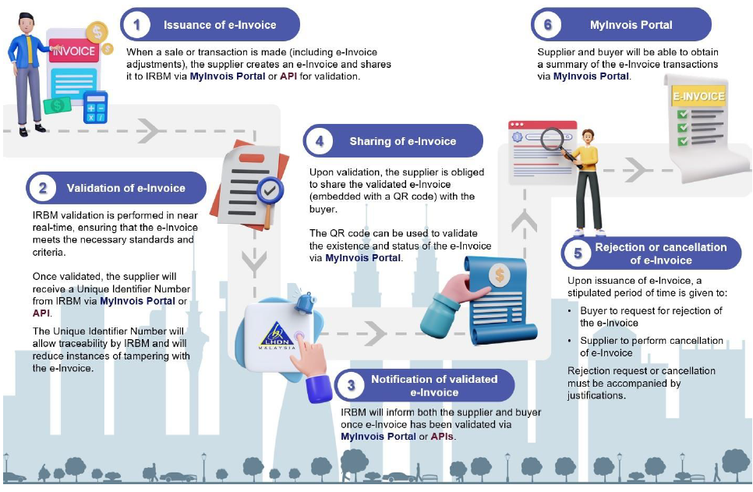
E-Invoicing in Malaysia | 2024
E-Invoice overview workflow
Rejection/ cancellation must be done within 72 hours from time of validation
E-Invoice mechanism
MyInvois portal hosted by IRB
Requires upfront investment and adjustments to existing systems.
Ideal for large businesses with substantial transaction volume.
API transmission methods include:
Direct integration of taxpayers’ Enterprise Resource Planning (ERP) system with MyInvois system
Through Peppol service providers
Through non-Peppol providers
Free and accessible to all.
Has the option for batch generation through spreadsheet upload for multiple transactions.
Back-up option when API connection is unavailable.
Types of e-Invoice transmission mechanism
Application Programming Interface (API)
LMC Taxation Services Sdn Bhd
general@lmc.com.my

Slide 3
E-Invoicing in Malaysia | 2024
The first step is always to get confirmation from the buyer if an e-invoice is required. If not required, supplier can consolidate and submit to IRB within 7 days after month end.
E-Invoice model workflow steps
A Digital Certificate will be issued by the IRB serving as taxpayer's identifier for online transactions and communications. The digital signature will verify that the submitted e-invoice originates from a specific taxpayer. The following outlines the key steps for both mechanisms of e-Invoice:
MyInvois Portal
API
Supplier to create e-invoice and submit via the MyInvois Portal, either individually or by batch.
Creation and submission
E-Invoice can be submitted via 3rd party technology solutions e.g. Point-of-Sale (POS) system / web portal / mobile app that are integrated with the IRB's MyInvois System. Supplier to attach digital signatures to e-invoices.
Supplier will receive a validated e-Invoice and a visual representation in PDF if successful. Otherwise, a resubmission is required.
API response will be sent to the supplier. Supplier to include QR code with validation link.
Validation
IRB will notify both supplier and buyer via the MyInvois Portal for successful invoice validation, invoice clearance and buyer's rejection.
IRB can notify supplier and buyer via the notification API.
IRB will notify both supplier and buyer via the MyInvois Portal for successful invoice validation, invoice clearance and buyer's rejection.
Notification
Supplier is required to share the validated e-invoice with the buyer.
Sharing
Buyer can directly access validated e-invoice via web portal / mobile app, or from the supplier.
Activities that require e-Invoice to be issued for each transaction (consolidation not allowed):
Automotive and aviation
Construction
Licensed betting and gaming
Luxury goods and jewellery
Wholesalers/retailers of construction materials
Payments to agents/ dealers/ distributors
LMC Taxation Services Sdn Bhd
general@lmc.com.my

Slide 4
E-Invoicing in Malaysia | 2024
Employment perquisites, benefits or expenses paid on behalf of employer
Employees are required to request for e-Invoices to serve as proof of expense and submit for claims (e.g. club membership, gym membership, professional subscriptions, parking etc).
The e-Invoices can be issued in the name of the employee, the employer or the existing document format issued by the supplier. This is not applicable for foreign suppliers as the IRB will accept foreign supplier’s receipts/ bills/ invoices directly as proof of expense.
Self-billed e-Invoice
The buyer should issue e-Invoice on his own (self-billed) for the following transactions:
Purchase of goods / services from a foreign seller
E-commerce (issued by platform providers)
Interest payment
Profit distribution (e.g. dividend). Exemption allowed for companies not entitled to deduct tax under S108 of the Income Tax Act 1967 and listed companies
Payout to all betting and gaming winners (casino and gaming machines related are exempted until further notice)
Acquisition of goods or services from individual taxpayers who are not conducting a business
Payment / credit to taxpayers recorded in a statement / bill issued on a periodic basis (e.g. rebate)
Payments (monetary or otherwise) to agents/ dealers/ distributors
Recipient is required to issue e-Invoice within the same month for all foreign income (e.g. foreign profits, dividend etc) received in Malaysia as proof of income.
Disbursement and reimbursement
Where taxpayer incurs disbursement and reimbursement, it should present these separately (e.g. one line for service fee charges and another line for disbursement / reimbursement) in the e-invoice.
Where taxpayer only pays on behalf and the supplier had issued e-invoice directly to the buyer. The taxpayer is not required to issue a separate e-invoice on such payment on behalf.
LMC Taxation Services Sdn Bhd
general@lmc.com.my

Slide 5
E-Invoicing in Malaysia | 2024
Field requirements in e-Invoice
There are 55 data fields, and the following table summarises the fields for various scenarios:
LMC Taxation Services Sdn Bhd
general@lmc.com.my

Slide 6
E-Invoicing in Malaysia | 2024
Field requirements in e-Invoice
The following table summarises the basic fields required in e-Invoice for various scenarios:
LMC Taxation Services Sdn Bhd
general@lmc.com.my

Slide 7
E-Invoicing in Malaysia | 2024
Field requirements in e-Invoice
The following table summarises the additional fields required in e-invoice:
LMC Taxation Services Sdn Bhd
general@lmc.com.my

Slide 8
E-Invoicing in Malaysia | 2024
Field requirements in e-Invoice
The following table summarises the additional fields required in e-invoice:
LMC Taxation Services Sdn Bhd
general@lmc.com.my

Slide 9
E-Invoicing in Malaysia | 2024
Field requirements in e-Invoice
The following tables summarises the fields required in the annexure of e-Invoice.
This following is applicable to transactions where goods are shipped to a different recipient and /or address (i.e. different from buyer's details):
The following is applicable to import and export of goods
The following are additional optional fields to be included in Annexure to the e-invoice
LMC Taxation Services Sdn Bhd
general@lmc.com.my

